Slide 1
SDL Mini Project Report
SCTR’s ,PUNE INSTITUTE OF COMPUTER TECHNOLOGY,PUNE-411043
DEPARTMENT OF COMPUTER ENGG.
ACADEMIC YEAR: 2020-21(SEM 1)
Group ID:
31161 - Shreya
31164 - Prathamesh S.
31168 - Tanushree
31170 - Prathamesh T.

Slide 2
Problem Statement
Design an Android app to simplify the process of Final Year project allocation. Students and Professors can easily join groups according to their domain and subdomain of interest.

Slide 3
Title: ColabCode - BE the project
Motivation:
BE project allocation is a tedious work
App simplifies the whole process of allocation of Students and Teachers according to their domain of interest
Reduces time and manual work

Slide 4
Survey
No such app existed before

Slide 5
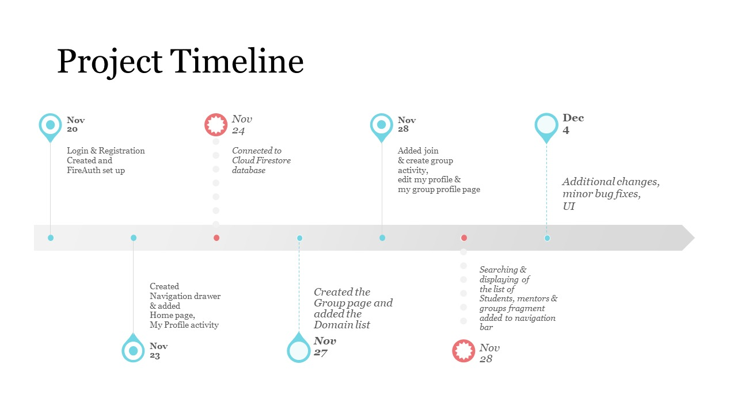

Slide 6
Requirement Gathering And Analysis
Who will be involved in the project?
Students and Professors
What are the risks for the requirements gathering process?
Privacy of data taken from the users
What is our ultimate goal in understanding our project requirements?
Reduce the manual work of project allocation
Can easily go through all the projects
Easy to access even during lockdown period

Slide 7
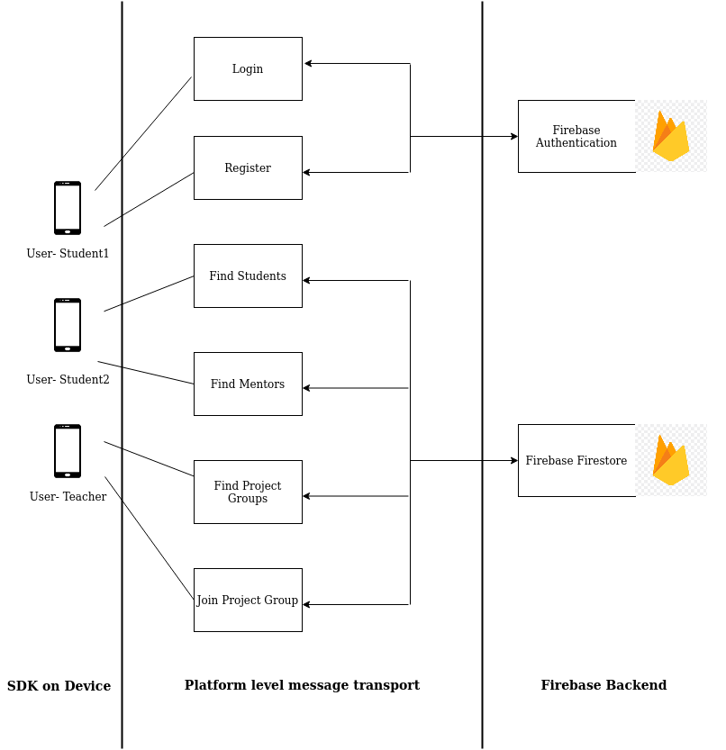
Architecture Diagram

Slide 8
Requirements
Hardware: PC, i7 processor, 8GB RAM
OS: Windows/ Ubuntu
Software: Android Studio 4.1.1, Cloud Firestore

Slide 9
Algorithms
https://github.com/TanushriPatil/SDL-Mini-Project

Slide 10
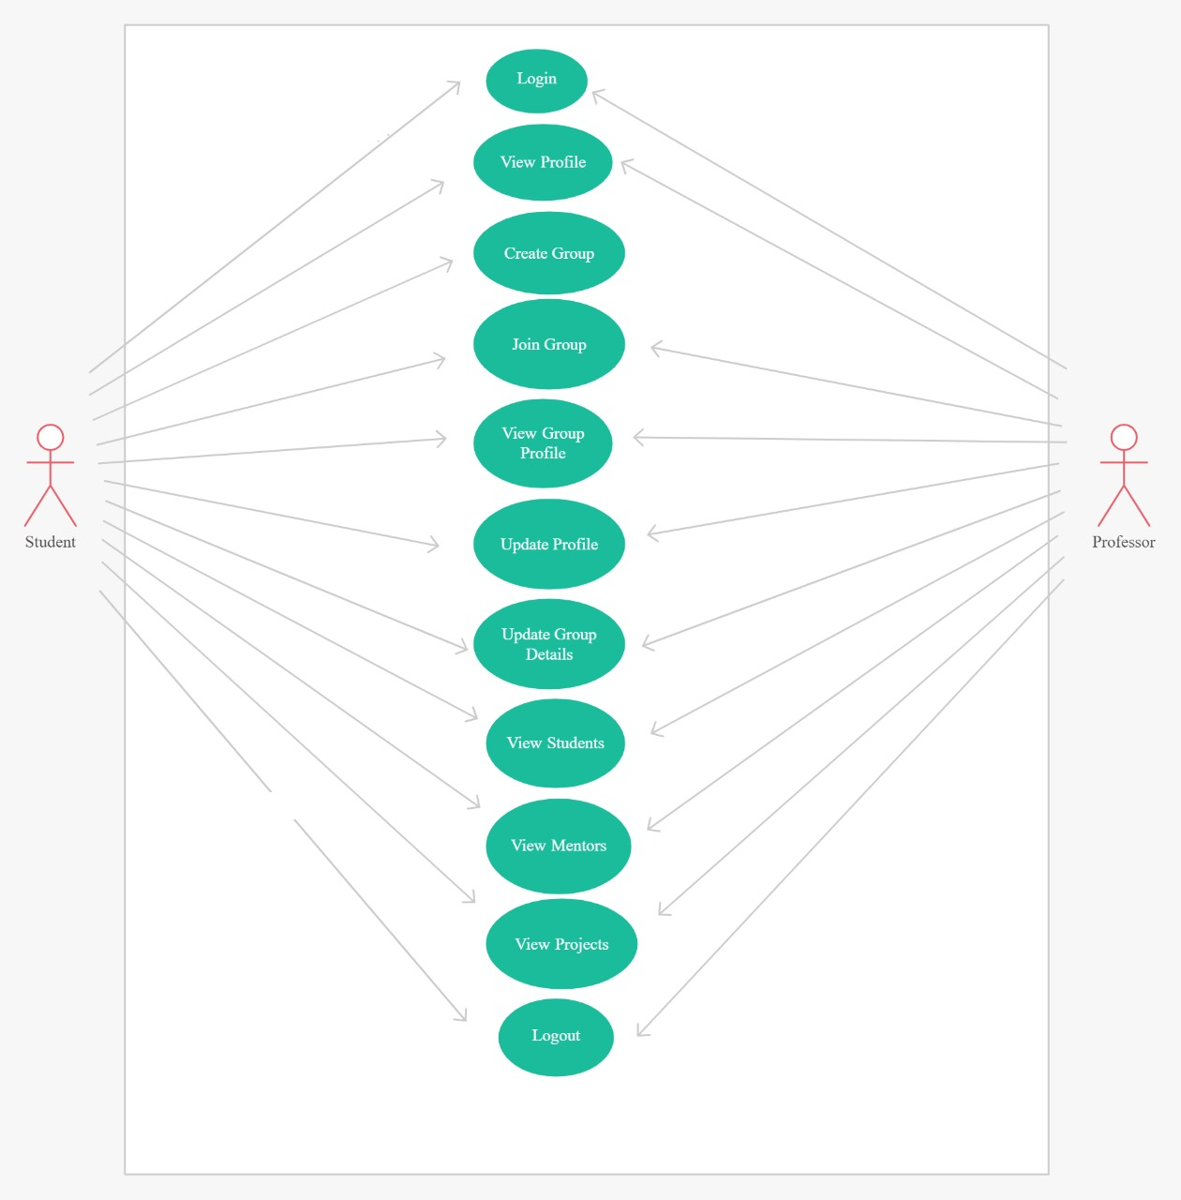
High Level Design (Use cases)

Slide 11
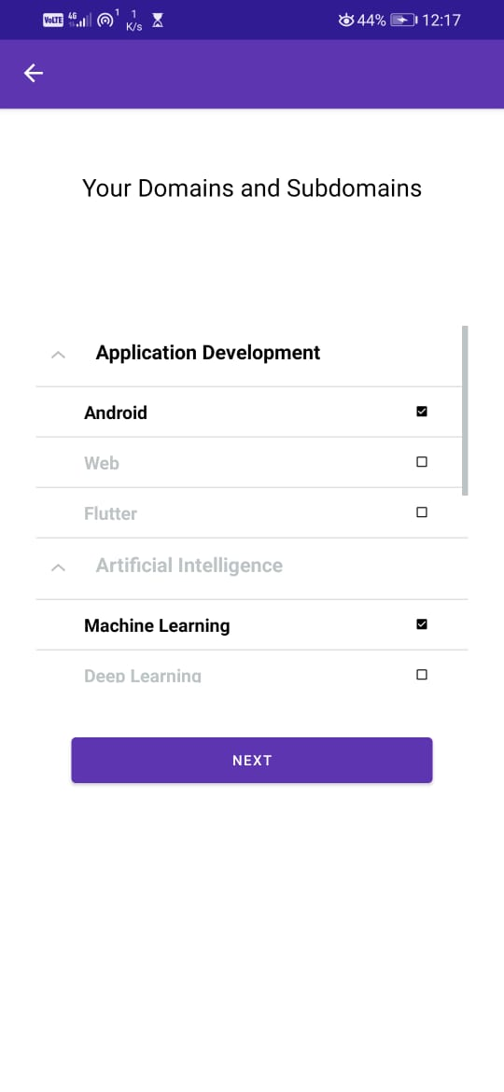
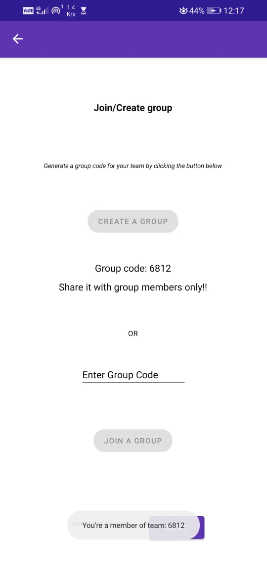
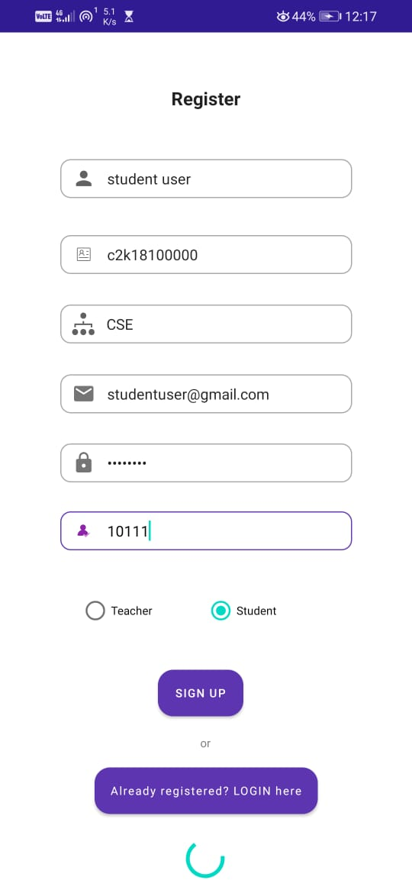
UI:
Student registration, selection of domain and creation of group

Slide 12
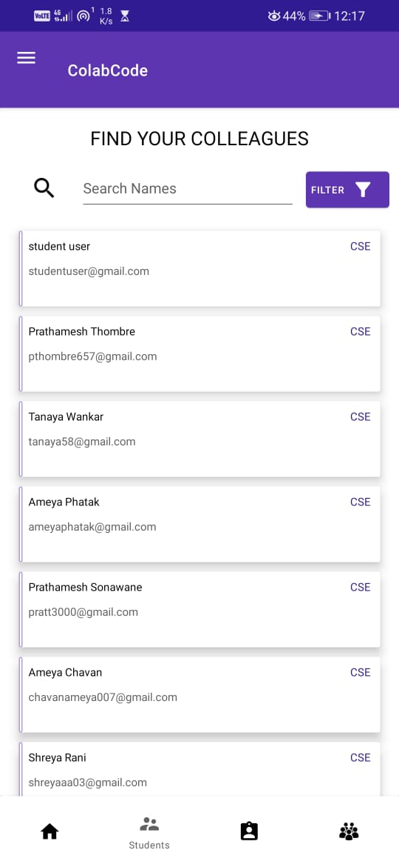
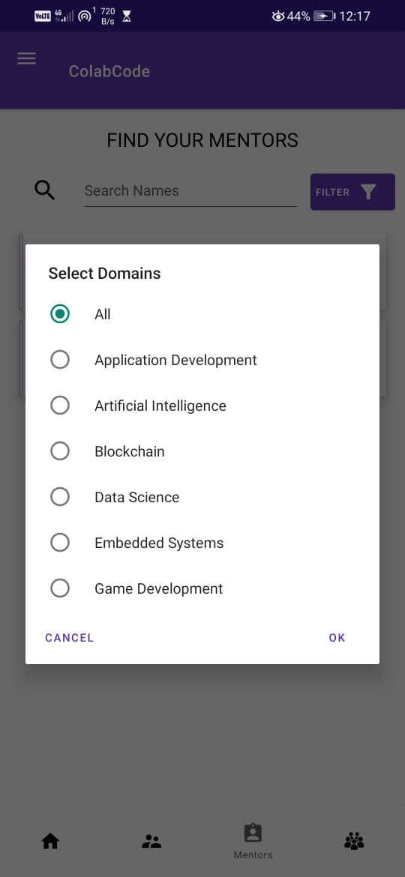
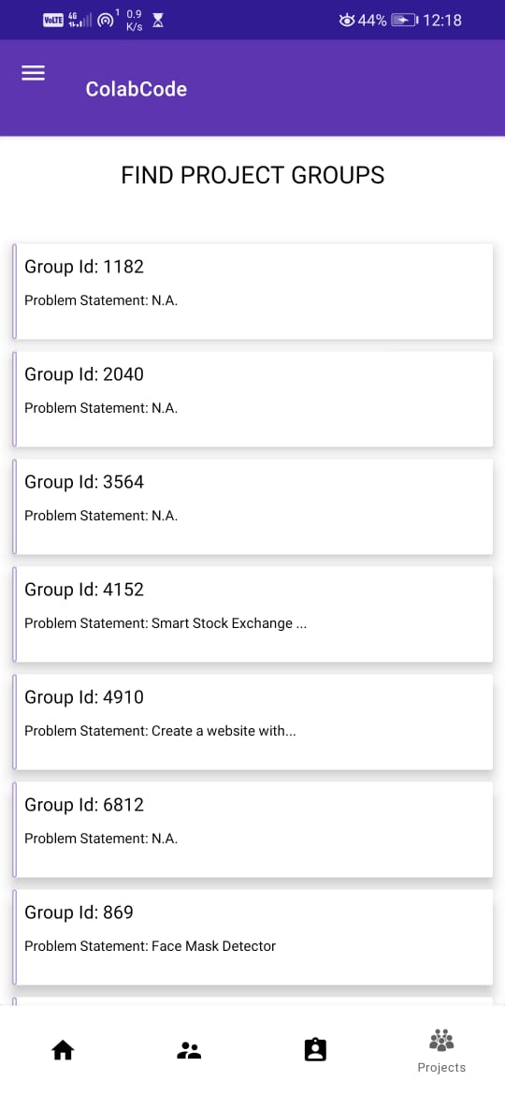
Find your colleagues, teachers and groups

Slide 13
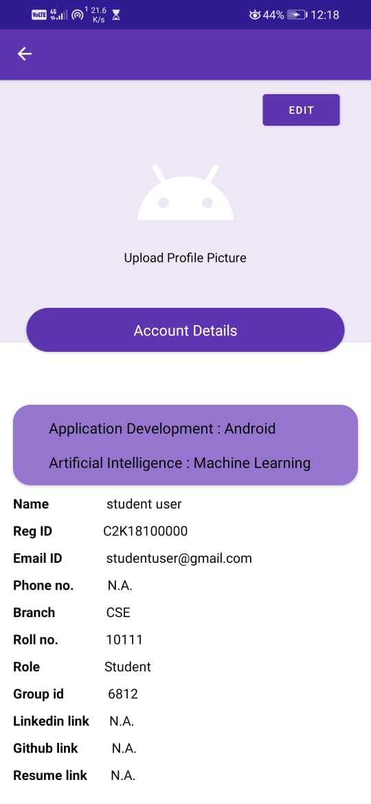
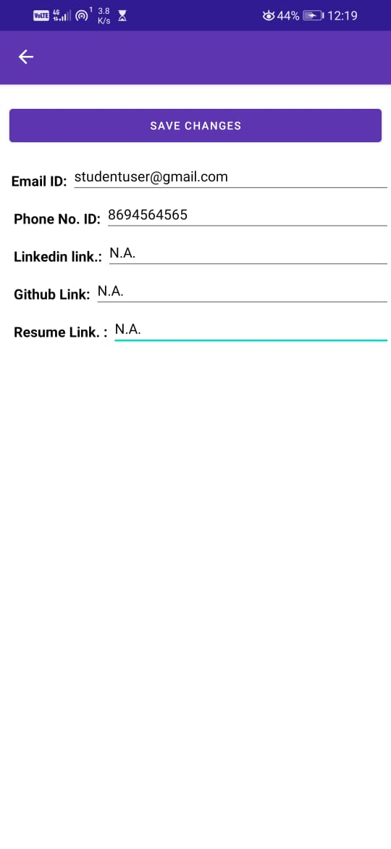
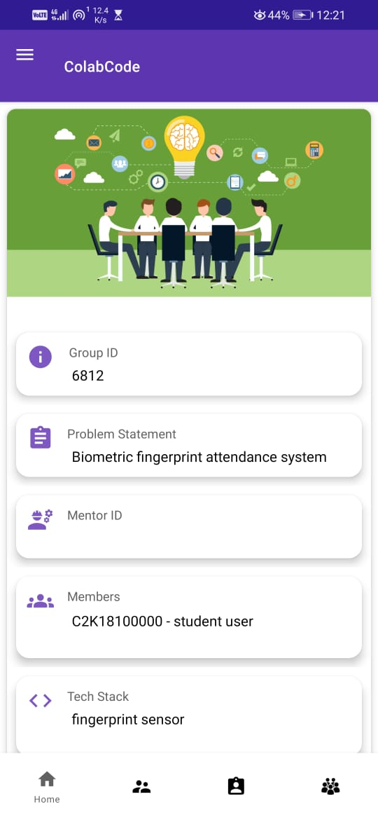
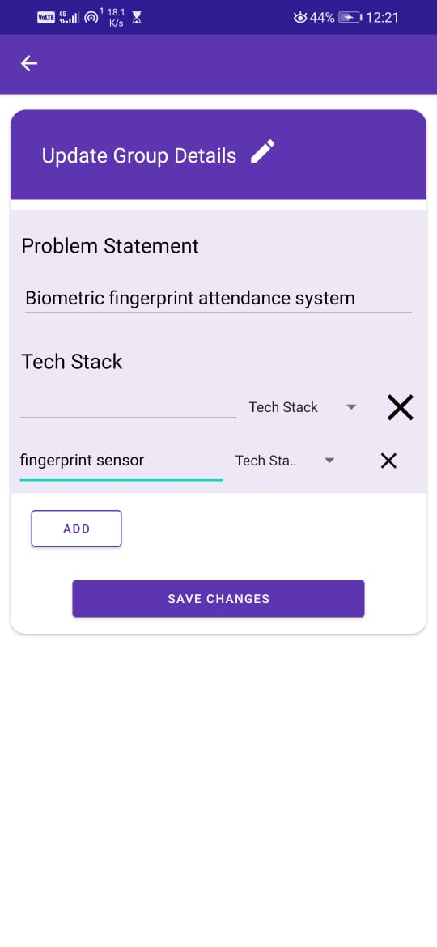
My profile, edit profile and My group, edit group

Slide 14
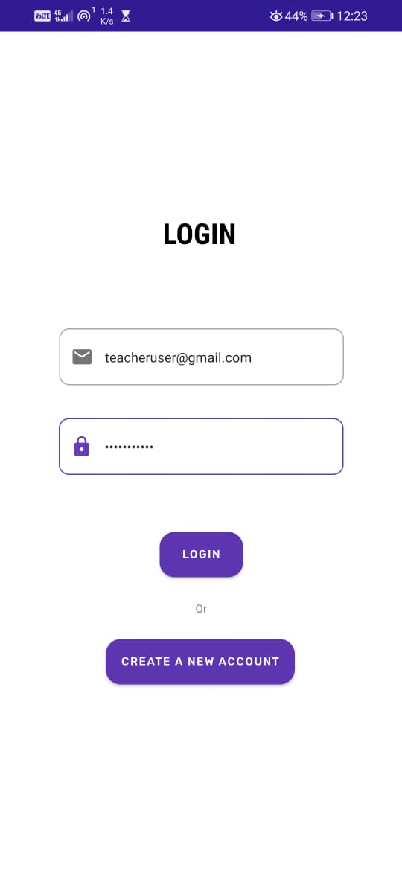
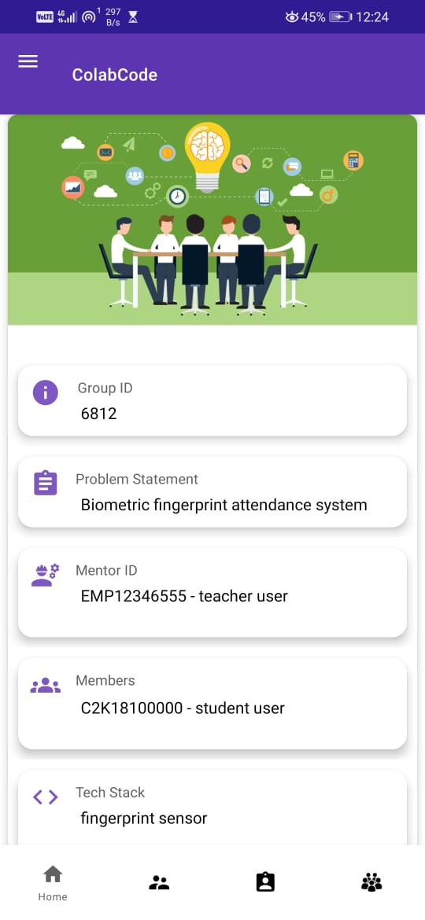
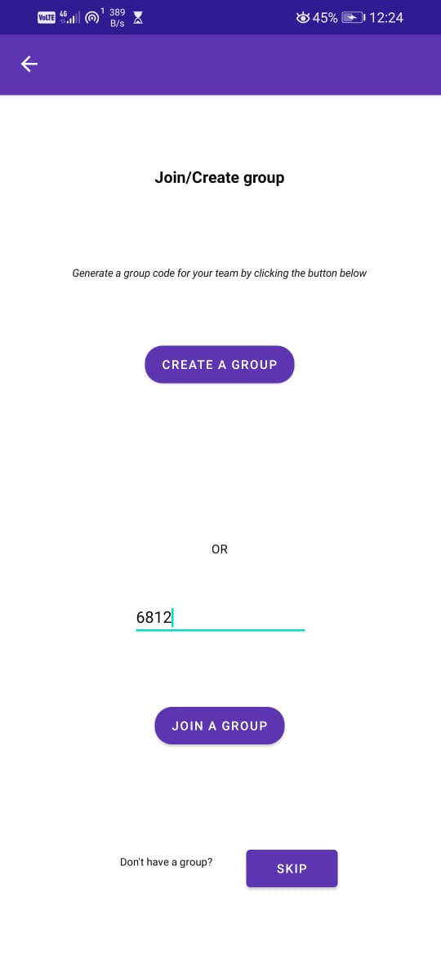
Login, home, join group

Slide 15
Future Scope
Integration with Chat Bot
Group Members can chat with each other and Mentor
Invite Request can be sent to Student/ Mentor/ Group
Submission of Projects through this app
Recommendation System to suggest Group Members and Mentor using ML Algorithm

Slide 16
Conclusion
We successfully created an app that will make it easier for the students and teachers to view the domains, and groups and join them easily.

Slide 17
References
https://developer.android.com/studio/intro
https://firebase.google.com/docs

